Slide 1
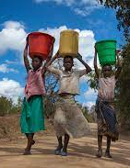
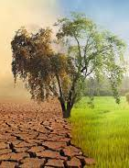
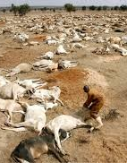
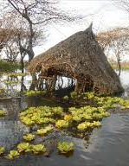
Overview of Climate Change And Burden Of Disease In Sub-Saharan Africa

Slide 2
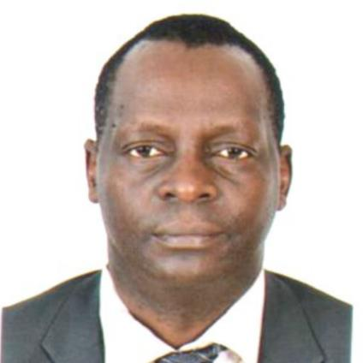
Global Health Research Group –Clean Air (Africa) Directorship
Prof. Dan Pope
Dr Elisa Puzzolo
Dr James Mwitari
Notes:
Honorables, Distinguished conference participants, ladies and gentlemen. A very good morning to all of you.
It is an honor to be here on behalf of the Clean Air Africa, as a partner of Kenya Health and climate change conference 2023 to speech on climate change and burden of disease in sub-Saharan Africa

Slide 3
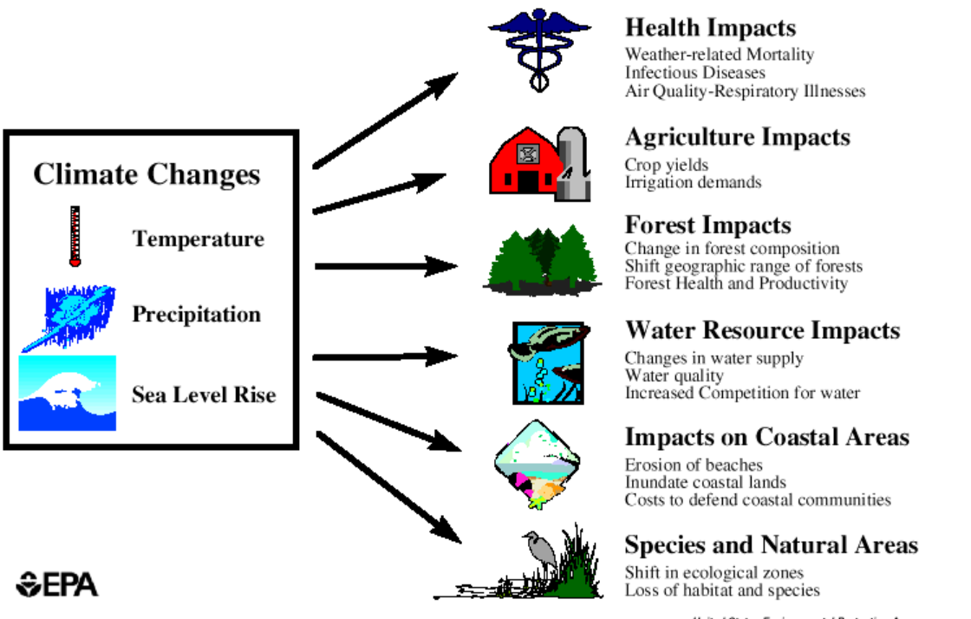
Introduction –Climate change
Results to:
Additional impact is on economic, due to delayed development, especially in Africa.

Slide 4
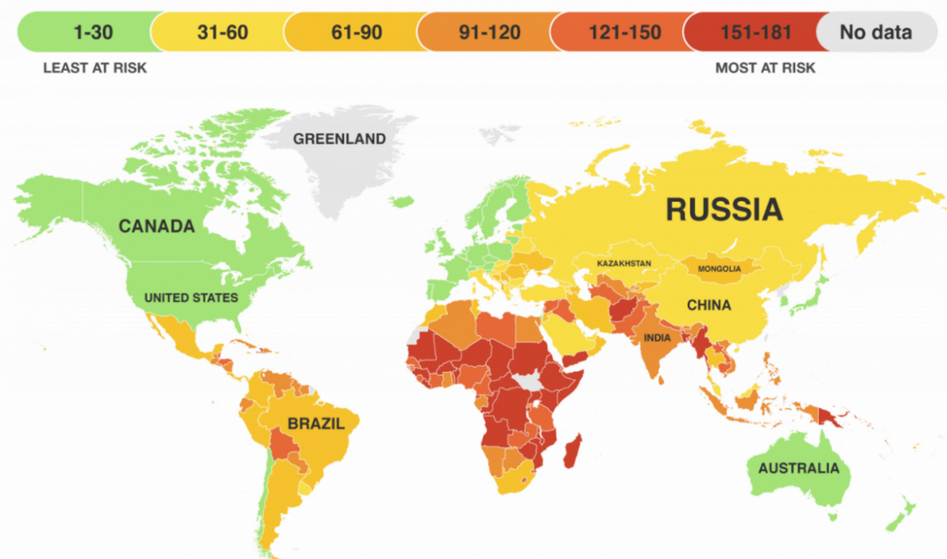

Africa suffer the most consequences related to the effects of climate change.
Due to geographic and micro-climate differences, socio-economic conditions, the quality of existing health infrastructure, communication capacity, and underlying epidemiology.
Kenya ranking among the most at risk

Slide 5
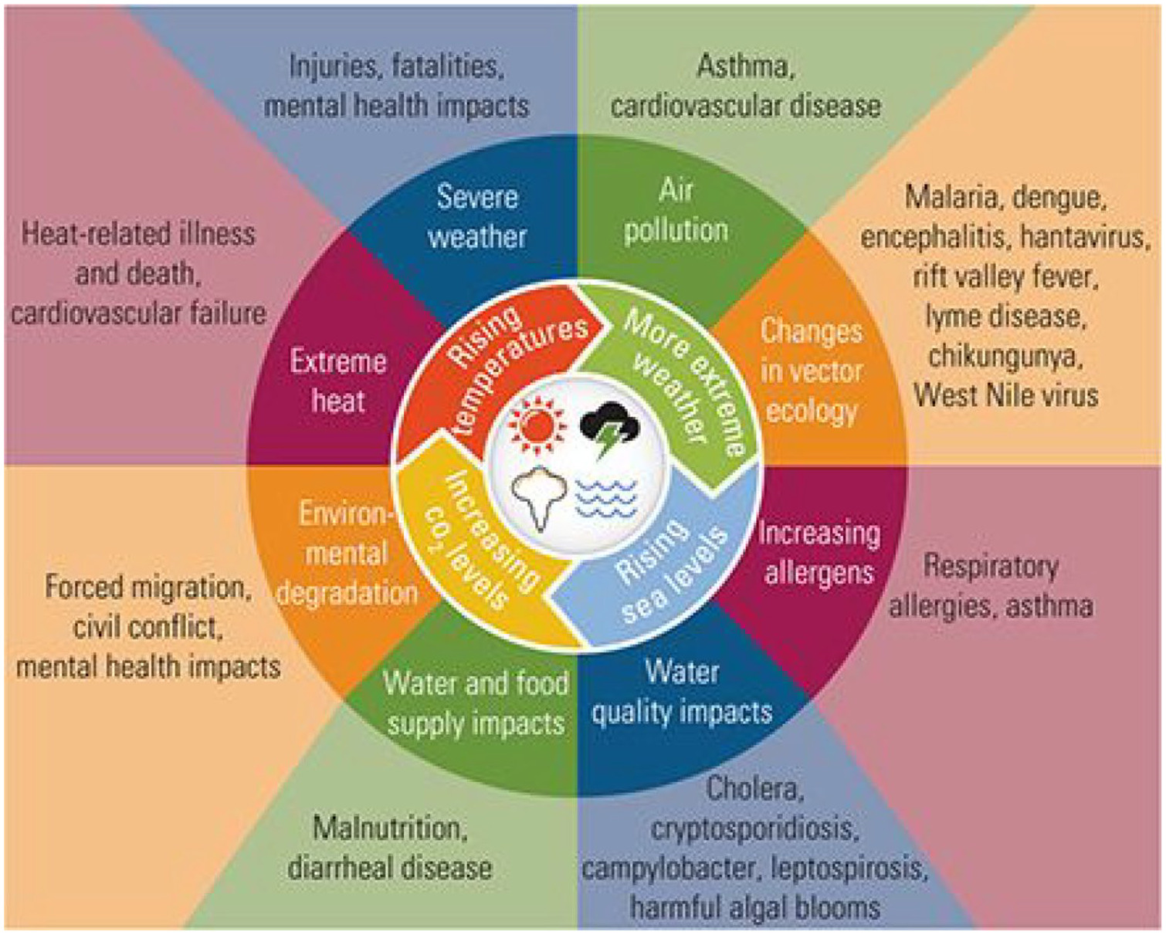
Health Related Impacts of Climate Change
Climate change has both direct and indirect impact on human health.
However, most of the health impact of climate change is indirect.
The most significant manifestations are malnutrition, neglected tropical diseases, diarrhea, malaria, and meningitis

Slide 6
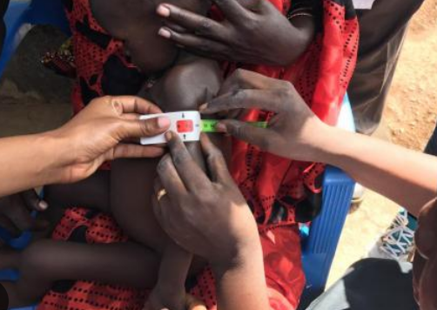
Malnutrition
Malnutrition causes 1.7 million deaths per year in Africa, largely contributed by climate change.
Child malnutrition will increase by 20% due to climate change and other determinants by 2050, caused by climate variability
More understanding of how climate change contributes to malnutrition is important if effective adaptation measures are to be implemented and governance structures improved.

Slide 7
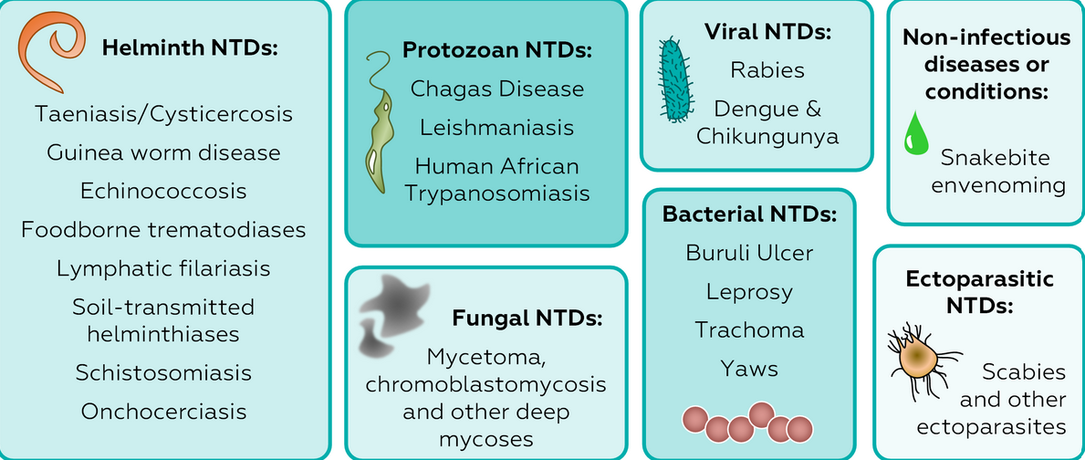
Neglected tropical diseases (NTDs)
NTDs are the most common conditions affecting the poorest 500 million people living in Africa.
NTDs are a group of 13 major disabling conditions distributed throughout Africa.
Many African countries are host to half of all pathogens defined as NTDs by the World Health Organisation.
Together, NTDs produce a burden of disease that may be equivalent to half of the malaria disease burden of Africa and more than double that caused by tuberculosis.

Slide 8
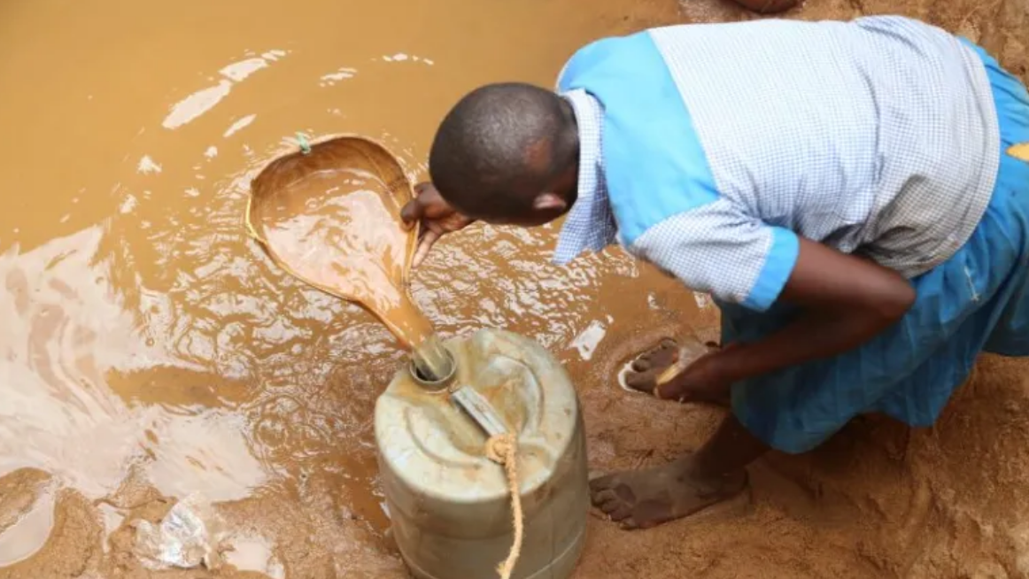
Diarrhoea
1.6 Million deaths occur each year globally due to ddiarrhoea, every year.
Diarrhoea is leading cause of child mortality in Kenya, accounting for 9% of all under five deaths (UNICEF 2018).Translation to 1,300 children dying every day
Temperature determines frequencies, spatial and geographical distribution.
The majority of pathogens that induce diarrhea in humans are water-borne, and, given that climate change will affect water availability and temperature, climate change could lead to additional cases of diarrhea.

Slide 9
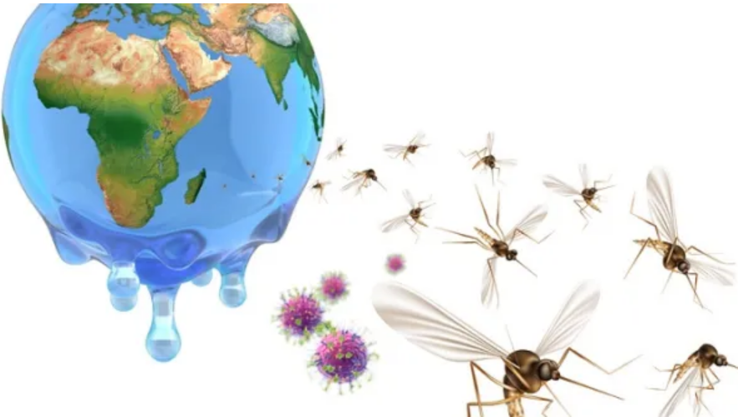
Malaria and Dengue Fever
Majority of 700,000 people who die annually of malaria live in sub-Saharan Africa.
Vector-borne diseases, such as mosquito-borne malaria and dengue fever, are among those undergoing resurgence and redistribution.
The combined effects of changing temperature and precipitation may lead to a more suitable environment for the spread of vector-borne diseases and the emergence of new ones in different parts of Africa.
Much climate malaria research in Africa suggests that malaria transmission, especially epidemic outbreaks, is associated with increased rainfall in typically dry regions and increased temperatures in high altitude, typically cool regions.

Slide 10
Meningitis
Meningococcal meningitis is caused by the bacteria Neisseria meningitidis, which exists all over the world.
It is one of Africa’s top three climate sensitive diseases.
Roughly 350 million people live in zones where the disease is endemic.
Humans are the only natural reservoir for the disease, and it is often spread between people via respiratory droplets or saliva.

Slide 11
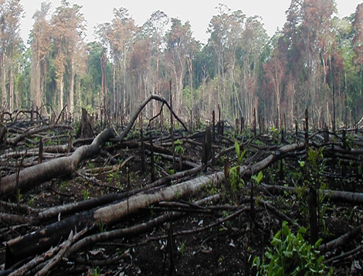
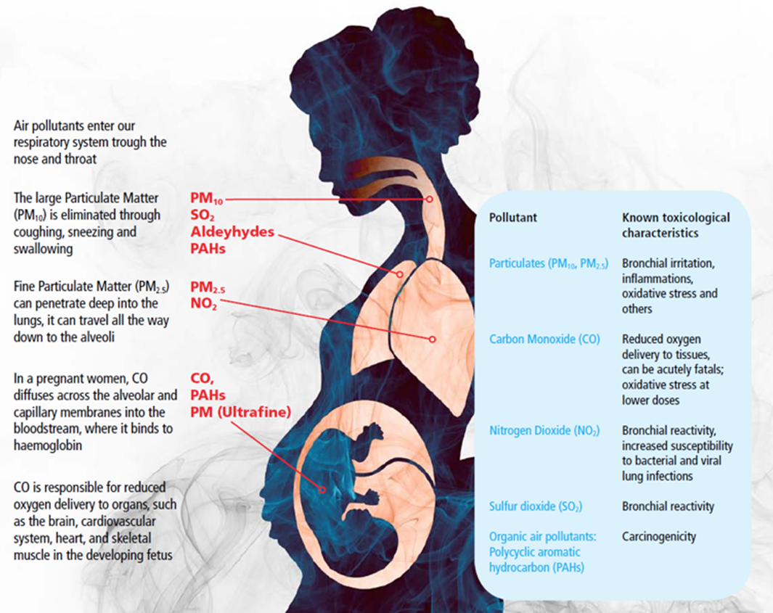
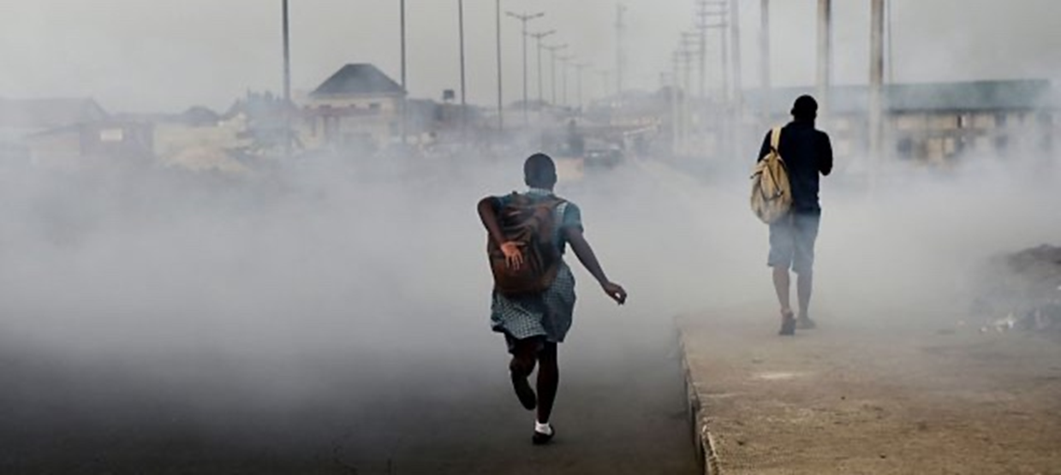
Household Air Pollution- an emerging disaster
Reliance on polluting fuels (e.g., coal, wood, charcoal, dung, crop waste) for household energy.
Burning solid fuels results to health damaging pollutants (PM, CO, NOx, SO2, PAH etc.)- Causes respiratory, cardiovascular and brain and cognitive impairment in children
Pollution from combustion of these fuels kills 23,000 deaths annually in Kenya; new data suggesting 124/100,000.
Deforestation contributes to increased atmospheric CO2 (associated with global warming).
Also, polluting fuels produces more than >¼ of black carbon – a short-lived climate forcing pollutant.
Notes:
Reasons why we should reduce and eliminate air pollution from our lives.
Polluted air is creating a health emergency- threat to unborn children, women cooking over open fires. According to WHO, 7 million premature deaths are attributable to air pollution—a staggering 800 people every hour or 13 every minute. In Kenya its 23k with new data suggesting 124/100,000
2. Children are most at risk – 600,000 children die each due to breathing polluted air (WHO). Breathing dirty air harms brain development, leading to cognitive and motor impairments. Household air pollution is particularly harmful to women and children due to their traditional home-based roles in many cultures. About 60 per cent of HAP-related deaths globally are among women and children, and more than half of all pneumonia deaths in children under five are attributed to HAP.
3. Pollution and poverty go hand in hand – affects poor people who can't afford clean fuel thus global social injustice and inequality
4. The cheaper the fuels, the higher the costs - Clean cooking and heating fuels and technologies are out of reach for low-income families, so polluting alternatives are the norm with over 3 billion using biomass and 3.8 million dying
5. The right to clean air is a human right- enjoys the right constitutional status in over 100 countries Kenya among them

Slide 12
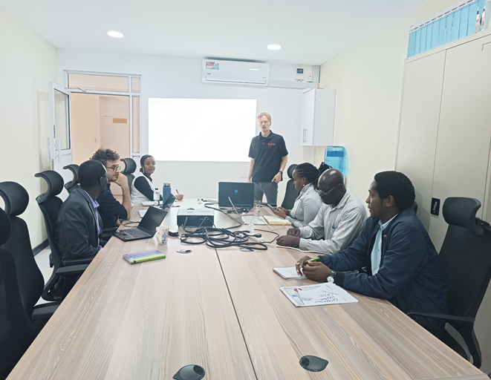
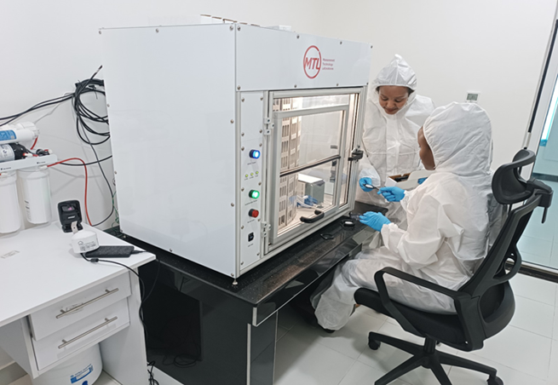
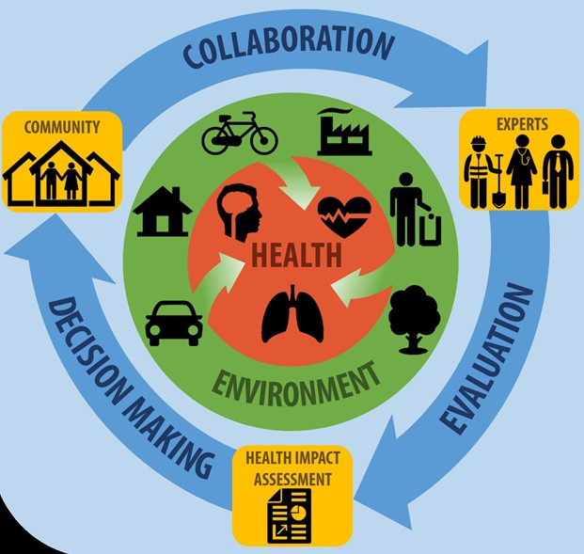

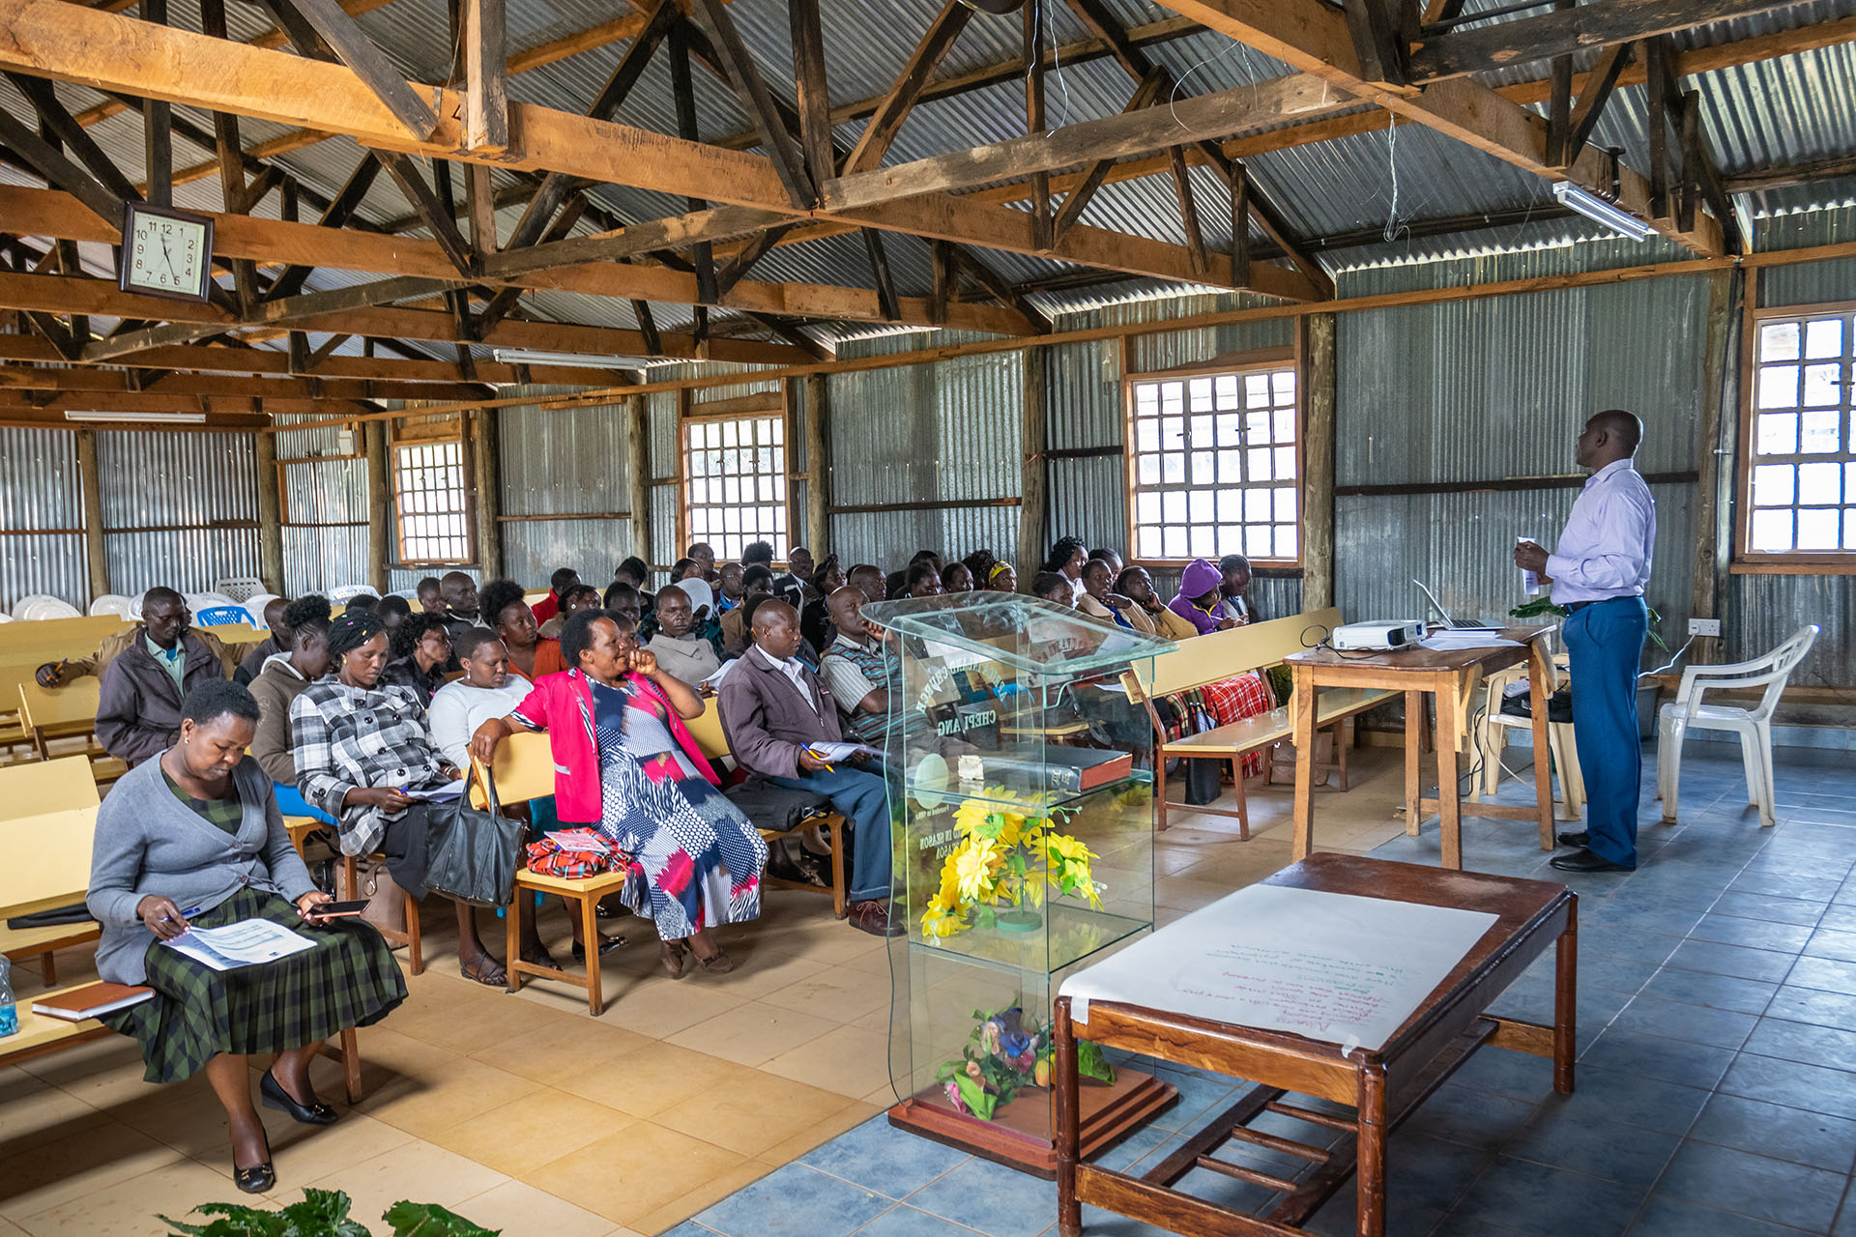
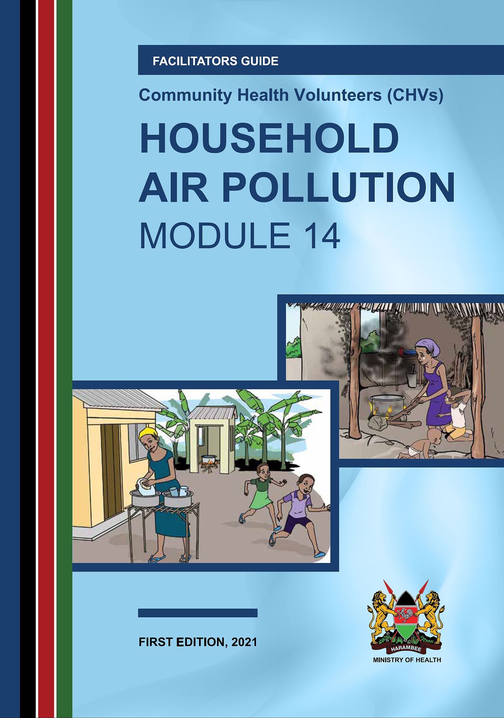
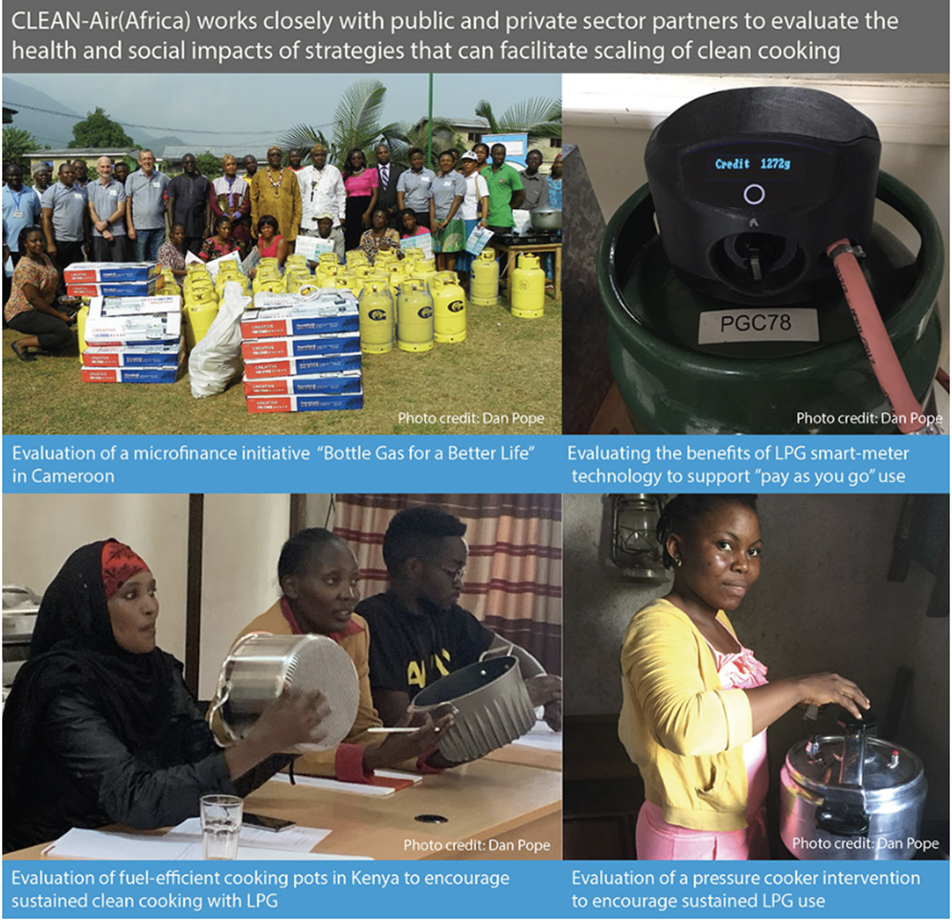
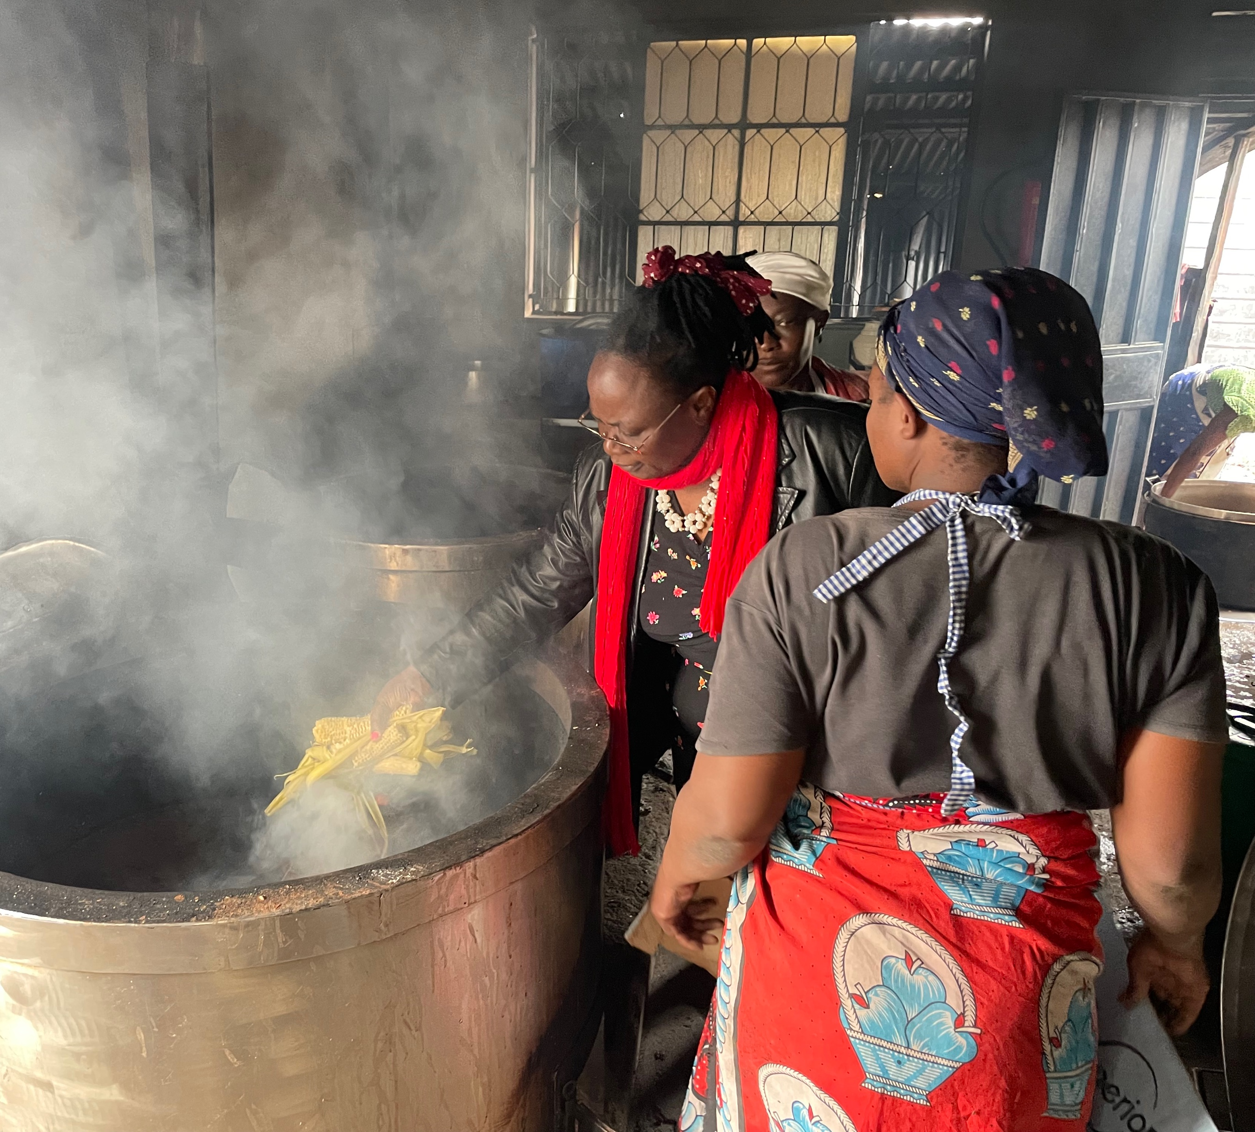
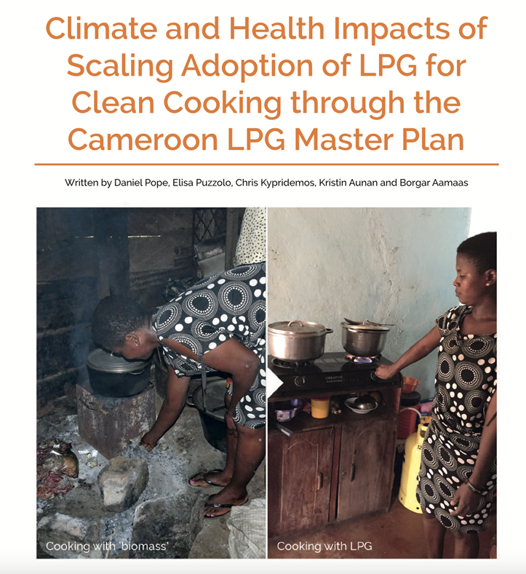
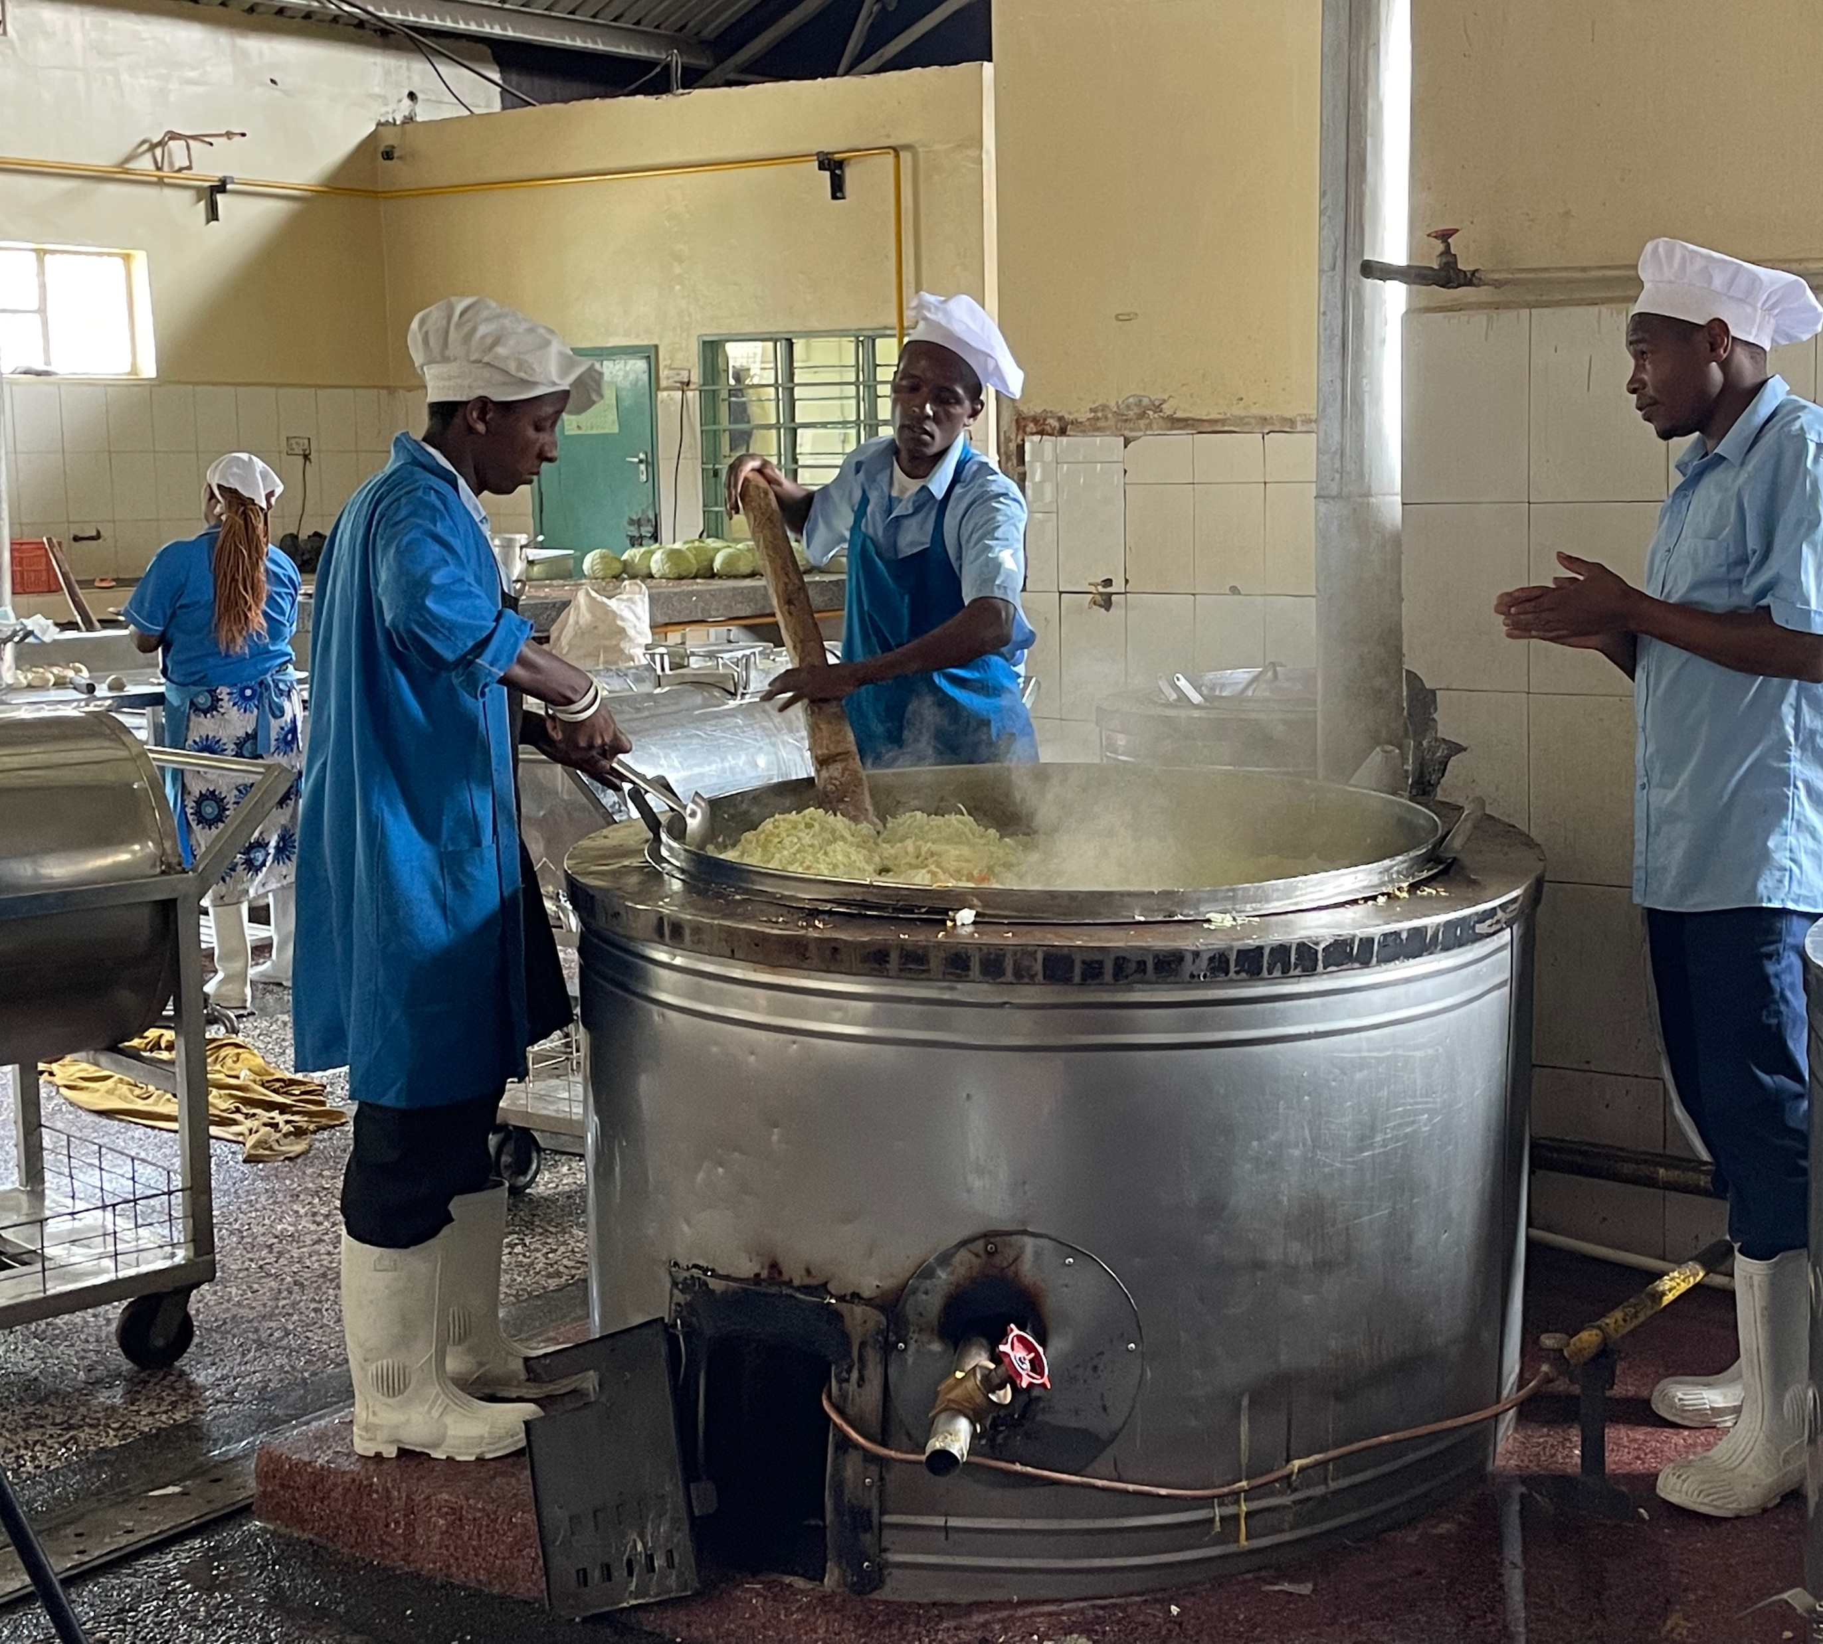


Clean Air Africa Leading the Initiatives
2. Sub-Saharan African Centre of Excellence in air pollution monitoring, for climate change and health
1. Capacity building and health system strengthening
State-of-the-art gravimetric filter weighing and analysis lab (including high tech- air quality monitors)
Highly trained experts on air pollution and health (including air quality lab technicians)
4. Institutions and Community Research-based Strategies for transitioning to clean energy
5: Engage and influence policy makers
3. Offering Short courses on air pollution

Slide 13
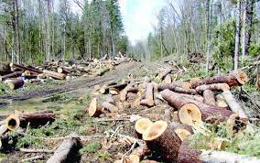
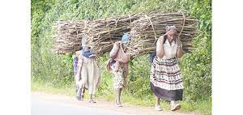
Benefits of Adopting Clean Fuels for Cooking- Kenya
Wood fuels contribute to climate change through unsustainable deforestation and emission of short-term climate forcing products of incomplete combustion
40,000 Public boarding school: 6.7M tons wood from the 12.13% each year by schools.
6.7m tons of burnt wood and 167.5m tons equivalent of CO2 produced per year will be prevented.
Over 23,000 premature deaths averted.

Slide 14
Conclusions
The impact of climate change on health occurs both directly and indirectly.
Africa is particularly vulnerable to the health effects of climate change.
African countries have begun to address climate and health issues.
More research is needed to enable the design of effective responses and policies to address the health impacts of climate change.

Slide 15
Recommendations
  Invest resources in public health infrastructure in Africa to improve its quality.
  Offer preventative measures can help the health sector in Africa to combat most climate-sensitive infectious diseases, including malaria, meningitis & NTDs
  Create awareness of knowledge management platforms for sharing information, skills, and technology, to increase effectiveness in addressing the health and climate.
  Offer research-based responses, actions, and policies addressing climate change.
  Need for improved regional modelling of climate change so that more reliable predictions of the potential impacts on human health can be made.

Slide 16


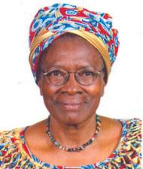

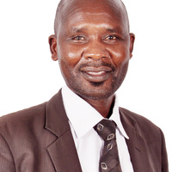



Thank you. Acknowledging KEMRI-CAA team
Dr James Mwitari
Dr Evans Amukoye
Gohole Arthur
Willah N. Simiyu
Nancy Chebichii
Prof. Miriam Were
Sophie Matu
Lolem Lokolile
Dr. Jonathan Abuga
Hillary Chebon
Joan Kimathi

